Slide 1
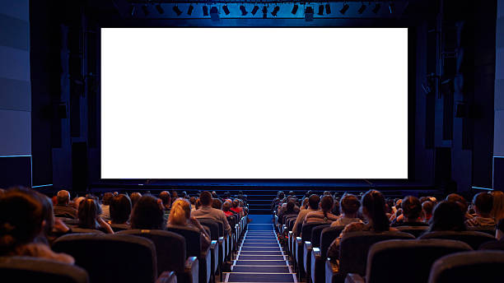
It’s Back!! 2024-25 Contest

Slide 2
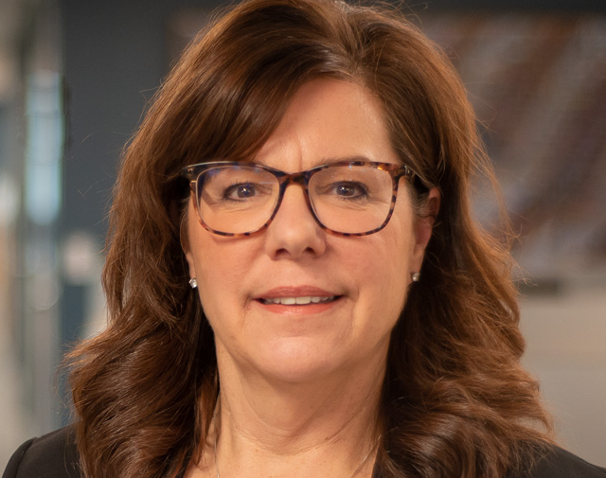
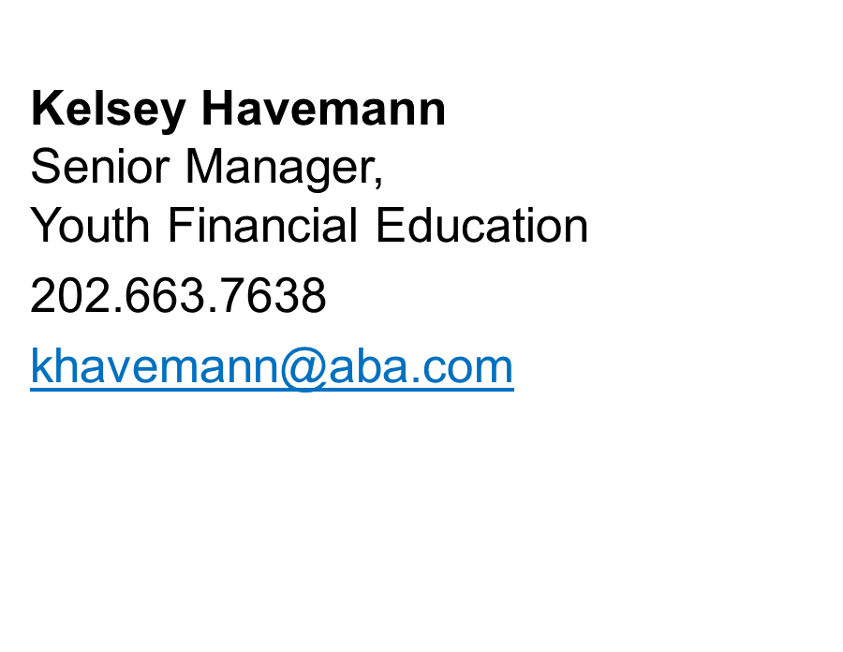
ABA Point of Contact
aba.com/LightsCameraSave

Slide 3
Housekeeping
Webinar is being recorded.
Slides and recording will be emailed.
Ask questions in the Q&A pod.
We’ll get to questions at the end!
aba.com/LightsCameraSave

Slide 4
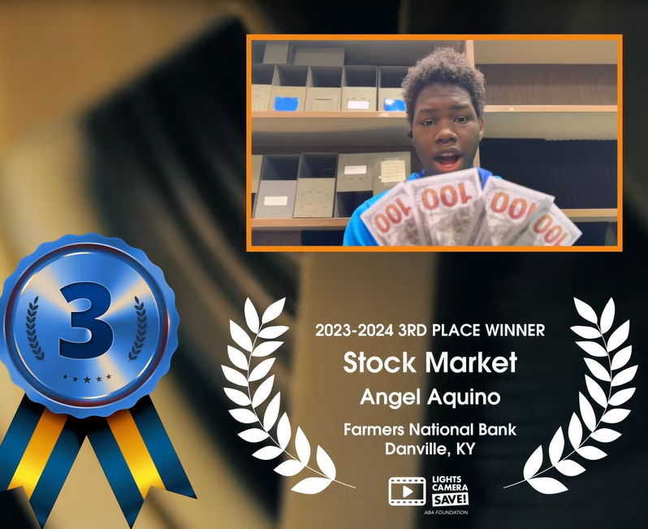
WHAT is Lights, Camera, Save?
Video contest for teens
Chance to give away someone else’s $$$$$
EASY engagement in your community
2023-24 Winners
aba.com/LightsCameraSave

Slide 5
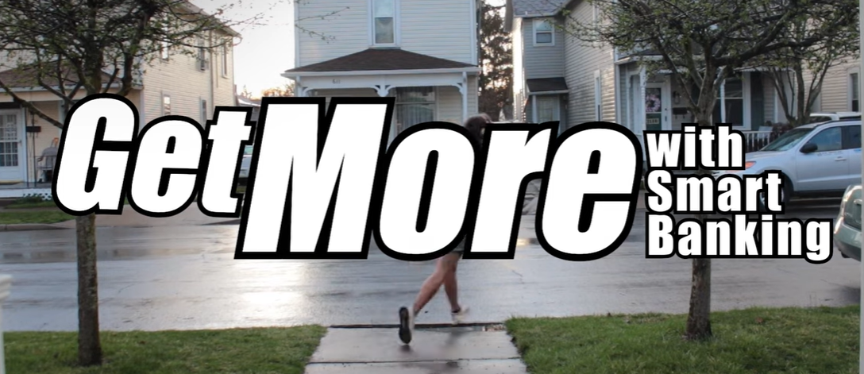
WHY Lights, Camera, Save?
Engage teens in their existing world
Literally TURNKEY for you
Builds community TRUST
Great PR for your bank
Kids Teaching kids
aba.com/LightsCameraSave

Slide 6
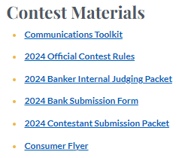
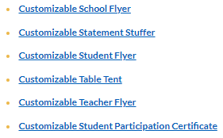
HOW Lights, Camera, Save?
Go to: aba.com/lightscamerasave to register then you’ll get the link to the resource page!!
aba.com/LightsCameraSave

Slide 7
WHO Lights, Camera, Save!
Calling all Marketers
#1 Hit your SCHOOLS!!!!!
production classes
clubs like DECA/FBLA)
USE the Socials
Community Theaters/Centers
Find Local chapters
Girl Scouts
Jump$tart
Junior Achievement
SkillsUSA
State Film Commission Offices
aba.com/LightsCameraSave

Slide 8
WHERE Lights, Camera, Save!
Bankers:
aba.com/LightsCameraSave
Non-Bankers:
lightscamerasave.com
Direct all marketing to lightscamerasave.com
aba.com/LightsCameraSave

Slide 9
WHEN Lights, Camera, Save!
Contest Opens Oct 1 - Dec 1
Students must be 13-18 years of age
as of October 1, 2024
Length: 30 seconds or less
Topic: ANY personal finance theme
Submission: Electronic only
aba.com/LightsCameraSave

Slide 10
Video Selection
Scoring Criteria:
40% Messaging
30% Production Value
30% Creativity
Bank Judging: Dec 2 – 9
Student File Upload to ABA:
By Jan 5, 2025
Instagram Judging: Jan 14–17
Final Round: Jan 21 – 24
Winner Announcement: February 24, 2025
aba.com/LightsCameraSave

Slide 11
Show Me the Money!!
Local Prizes: Optional
Up to each bank
National Prizes:
1st Place - $5,000
2nd Place - $2,500
3rd Place - $1,000
Bankers Choice: $500+ Bundle
Voted on and awarded at ABA’s Annual Community Bankers Conference in February 2025
aba.com/LightsCameraSave

Slide 12
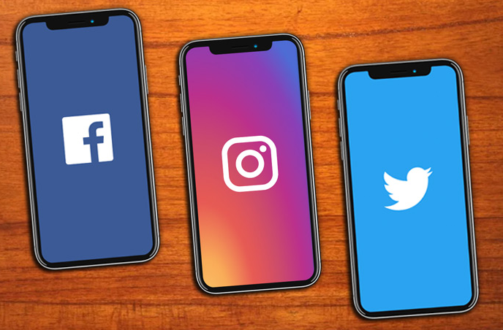
Social for Lights, Camera, Save!
#LightsCameraSave
Use the hashtag on Facebook, Twitter and Instagram so that your posts are discoverable by ABA and others
Follow Us!
Facebook:@AmericanBankersAssociation
Instagram: @americanbankersassociation
Twitter: @ABABankers
aba.com/LightsCameraSave

Slide 13
WHERE Lights, Camera, Save!
Register to Participate
FREE to Any Bank in USA
aba.com/LightsCameraSave

Slide 14
ABA Foundation has set a three-year, industry-wide goal: enable 5 million Americans to access pathways to prosperity. Join us by participating in these free programs.
aba.com/FinEd

Slide 15
aba.com/Foundation

